Slide 8
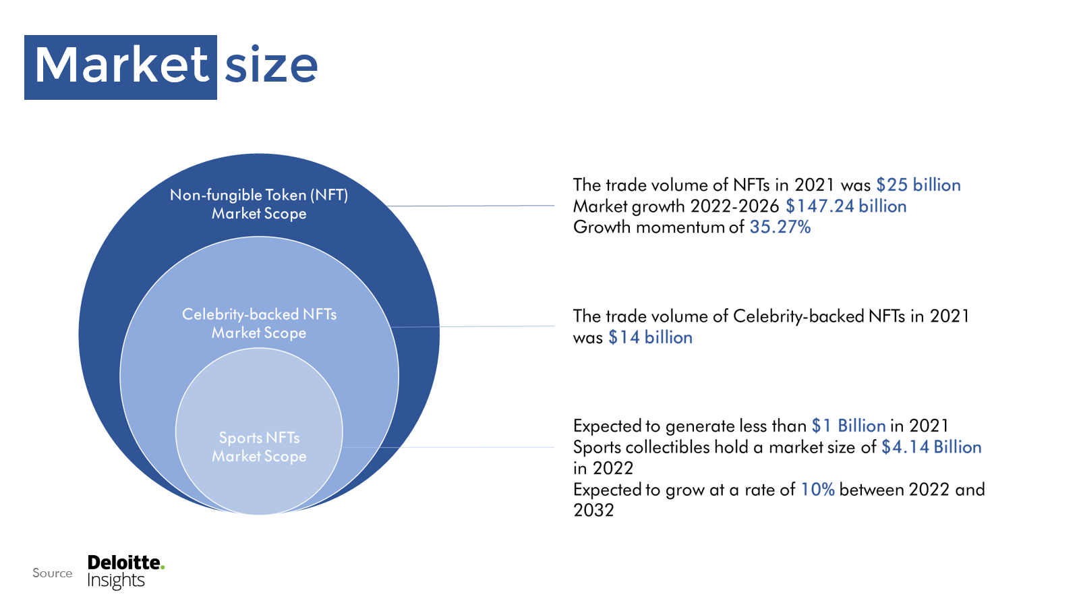

Slide 14
Notes:
Sorare (740M), Socios (Chiliz 66M)

